Slide 1
MODULE-2
BCSE306
Artificial Intelligence
Dr.Priyanka N
Assistant Professor Senior Grade-1
School of Computer Science and Engineering (SCOPE),
VIT Vellore,
Priyanka.n@vit.ac.in

Slide 2
Iterative Deepening Depth First Search(IDDFS)
Iterative deepening depth-first search (IDDFS) is an algorithm that is an important part of an uninformed search strategy just like BFS and DFS.
We can define IDDFS as an algorithm of an amalgam of BFS and DFS searching techniques.
In IDDFS, We have found certain limitations in BFS and DFS, so we have done hybridization of both the procedures for eliminating the demerits lying in them individually.
We do a limited depth-first search up to a fixed “limited depth”.
Then we keep on incrementing the depth limit by iterating the procedure unless we have found the goal node or have traversed the whole tree whichever is earlier.

Slide 3
Iterative Deepening Depth First Search(IDDFS)
In the uninformed searching strategy, the BFS and DFS have not been so ideal in searching the element in optimum time and space.
The algorithms only guarantee that the path will be found in exponential time and space.
So, we found a method where we can use the amalgamation of space competence of DFS and optimum solution approach of BFS methods, and there we develop a new method called iterative deepening using the two of them.
The main idea here lies in utilizing the re-computation of entities of the boundary instead of stocking them up.
Every re-computation is made up of DFS and thus it uses less space.

Slide 4
Algorithm
Now let us also consider using BFS in iterative deepening search.
Consider making a breadth-first search into an iterative deepening search.
We can do this by having aside a DFS which will search up to a limit. It first does searching to a pre-defined limit depth to depth and then generates a route length1.
This is done by creating routes of length 1 in the DFS way. Next, it makes way for routes of depth limit 2, 3 and onwards.
It even can delete all the preceding calculation all-time at the beginning of the loop and iterate. Hence at some depth eventually the solution will be found if there is any in the tree because the enumeration takes place in order.

Slide 5
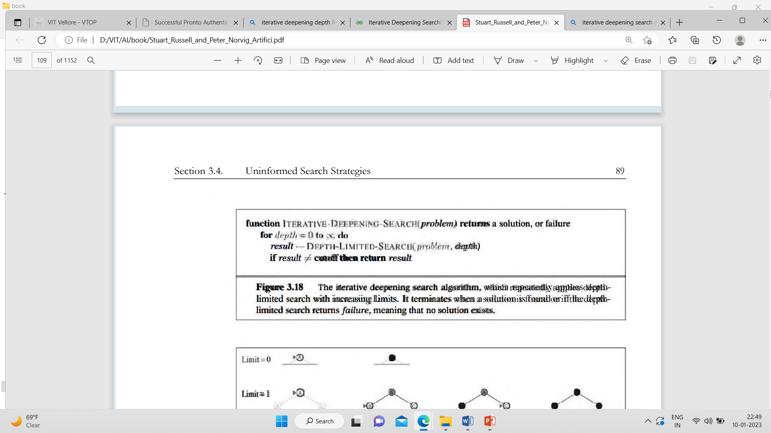
Pseudo-code for IDDFS

Slide 6
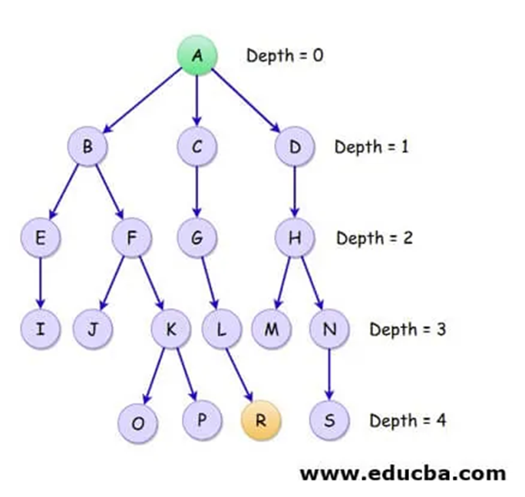
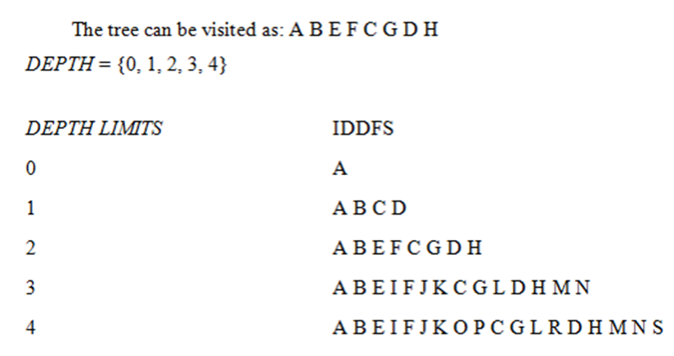
Example of Iterative Deepening Depth-First Search

Slide 7
Advantages
IDDFS gives us the hope to find the solution if it exists in the tree.
When the solutions are found at the lower depths say n, then the algorithm proves to be efficient and in time.
The great advantage of IDDFS is found in-game tree searching where the IDDFS search operation tries to improve the depth definition, heuristics, and scores of searching nodes so as to enable efficiency in the search algorithm.
Another major advantage of the IDDFS algorithm is its quick responsiveness. The early results indications are a plus point in this algorithm. This followed up with multiple refinements after the individual iteration is completed.
Though the work is done here is more yet the performance of IDDFS is better than single BFS and DFS operating exclusively.

Slide 8
Disadvantage
The time taken is exponential to reach the goal node.
The main problem with IDDFS is the time and wasted calculations that take place at each depth.
The situation is not as bad as we may think of especially when the branching factor is found to be high.

Slide 9
Performance Measures
The IDDFS is a completeness and optimal algorithm.
Time complexity is expressed as:
O(b^{d})and here d is defined as goal depth.
Space Complexity is expressed as:
O(b) and here b is defined as total nodes.

